Slide 1


Rumah Coding Course "Android Basic"
Studi Kasus Aplikasi "SekolahKu"
Day 3

Slide 2

First, Let's Discuss Your HomeWork
Try to create two more EditText. Email and Tanggal Lahir.
For Tanggal Lahir set android:clickable=true android:focusable=false and android:inputType="none".

Slide 3
Answer
s.id/1sz7

Slide 4
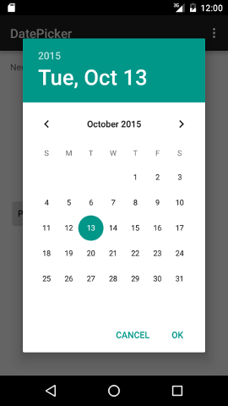
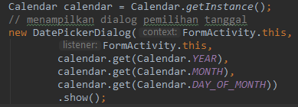
Date Picker Dialog
Open Date Picker Dialog when user click on Tanggal Lahir. Use this code to open Date Picker Dialog

Slide 5

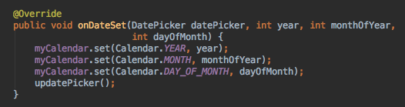
Date Picker Dialog
To listen when a date is set, modify FormActivity:
- Implement DatePickerDialog.OnDateSetListener.
- Override onDateSet method.

Slide 6
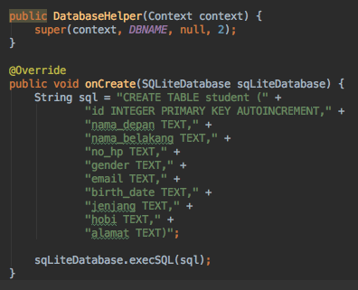
Modify Database
Open DatabaseHelper.java, add two more column and increase database version number to 2.
If you encountered unexpected error after database modification, try to uninstall the application on emulator.

Slide 7
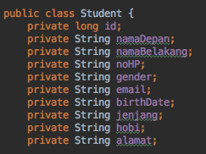
Modify Student Model
Add two more fields: email and birthDate.

Slide 8
Should We Modify StudentDataSource?
Of course, modify addStudent() and fetchRow() method to include email and birthDate.

Slide 9
The Last Step
Modify FormActivity
What should we modify? Find it by yourself!

Slide 10
Course Syllabus
Day 3
Custom Array Adapter
Create Detail Activity
Add Splash Screen
Activity Lifecycle
Intent
Up Navigation

Slide 11

Intent
An intent is an abstract description of an operation to be performed. It can be used with startActivity to launch an Activity.
To move from an Activity to another Activity, you can use intent. Use format Intent(Context, DestinationActivity).

Slide 12
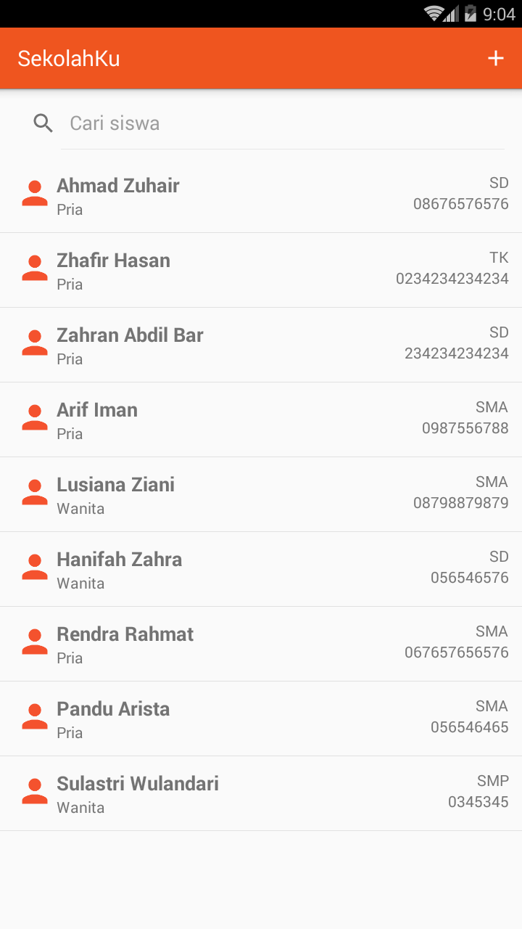
Task #1 Add plus menu item and go to FormActivity when it is clicked

Slide 13
If We Move to Another Activity What Happen With Previous Activity?
Previous Activity is still running, but in pause condition. We'll explore more about this when learning about Activity Lifecycle.
In our case, when user click plus menu item. FormActivity become an active screen and ListActivity become paused but still running in the background.

Slide 14
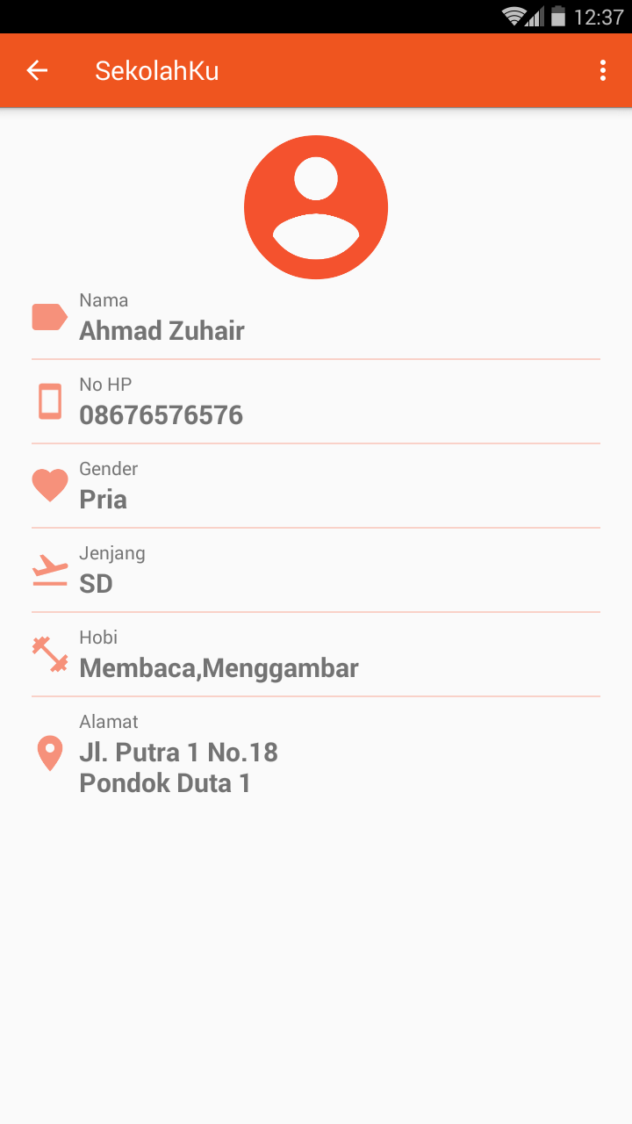

Providing Up Navigation
All screens in your app that are not the main entrance to your app (the "home" screen) should offer the user a way to navigate to the logical parent screen in the app's hierarchy by pressing the Up button in the action bar. This lesson shows you how to properly implement this behavior.
Use this code to show Up Navigation on an Activity

Slide 15
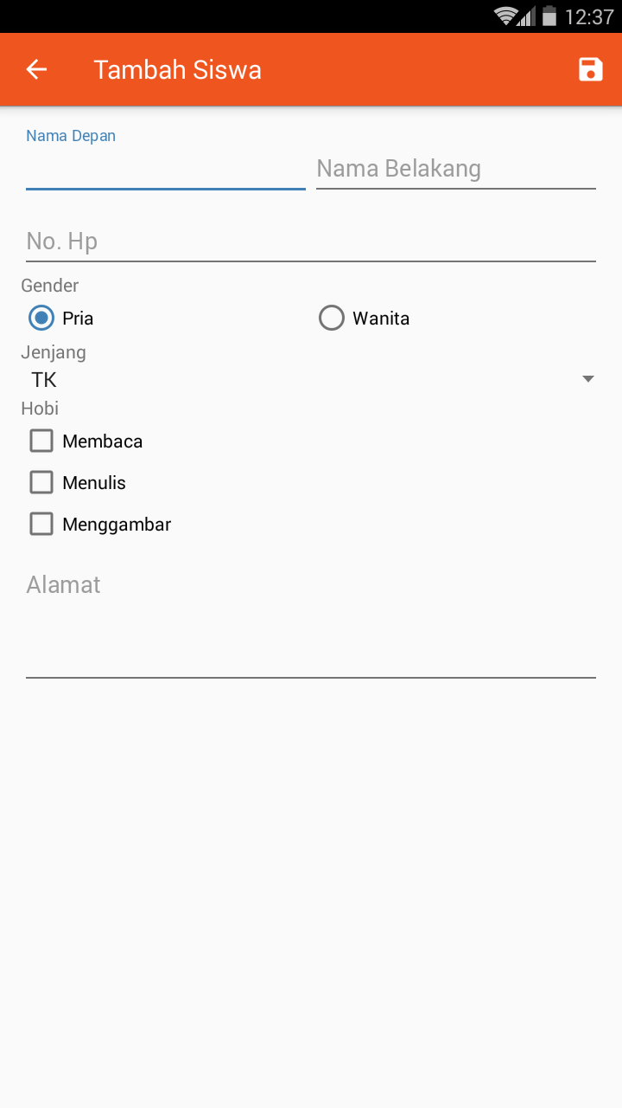
Task #2 Show Up Navigation on FormActivity

Slide 16

Destroying An Activity
When user click on Up Navigation, android will destroy current activity then make previous activity active.
In our case, if user click Up Navigation on FormActivity. FormActivity will be destroyed and ListActivity reactivated and appear on screen.
To destroy an activity manually, use can use this code:

Slide 17
Task #3 Destroying FormActivity after successfully saving student data

Slide 18
Where is the Saved Data?
After successfully saving data and ListActivity reactivate, we don’t see the student data on the ListView.
Actually the data has been saved on database, but not showing on ListView.
Try to close your application then open it again.
Now the data should appears on ListView.
So what happens? To understand this situation, you must understand about Activity Lifecycle.

Slide 19
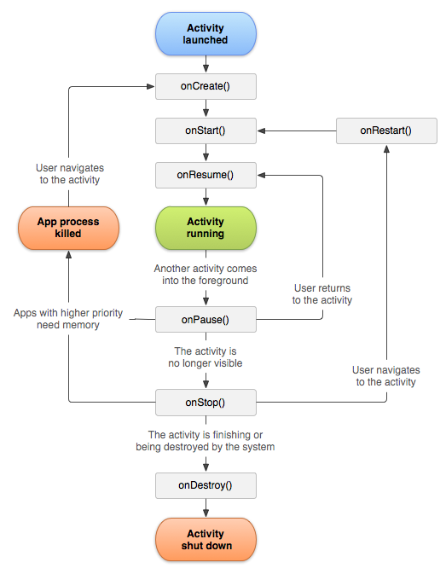
Activity Lifecycle
As a user navigates through, out of, and back to your app, the Activity instances in your app transition through different states in their lifecycle.
The Activity class provides a number of callbacks that allow the activity to know that a state has changed: that the system is creating, stopping, or resuming an activity, or destroying the process in which the activity resides.

Slide 20
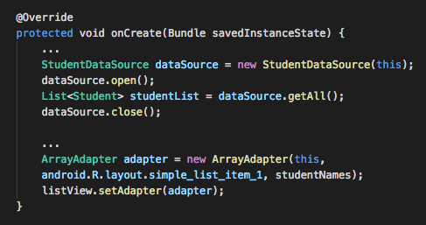
Now, Back to Our Problem When We Load Data From Database?

Slide 21
Task #4 Show new added data instantly without having to close your app

Slide 22
Custom Array Adapter
A custom array adapter is extended from the ArrayAdapter class and manages a specific type of data. It has a getView() method that's called automatically by the superclass each time the adapter needs to fill in data to present on the screen.
Step to create custom array adapter:
Create xml layout file
Create new java class extending ArrayAdapter
Override getView() method

Slide 23
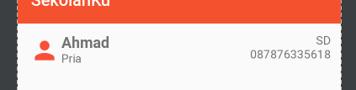
Task #5 Create XML Layout File

Slide 24
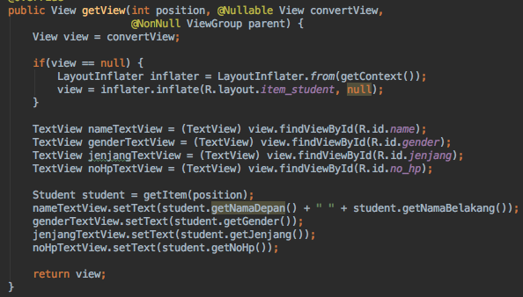
Task #6 Create StudentItemAdapter

Slide 25
Task #7 Modify ListView: Replace ArrayAdapter with StudentItemAdapter

Slide 26
Task #8 Create new Activity: DetailActivity
Note:
- The layout using nested LinearLayout instead of ListView
- Don't forget to add up navigation

Slide 27
How to know that an item on ListView clicked
Implement AdapterView.OnItemClickListener
Override method onItemClick().
Set onItemClickListener to the ListView: listView.setOnItemClickListener(this);

Slide 28
Task #9 Show item position on Toast when user click on ListView

Slide 29

Passing Data from an Activity to Another Activity
You can pass some data from active activity to another activity by using intent putExtra() method.
You can specify key and value to be send to other activity
You can pass multiple data to intent.

Slide 30
Task #10 When user clicked on student item, passing student id to DetailActivity instead of showing a Toast.

Slide 31

Read the Passed Data
In the destination activity you can read the passed by using intent using get*() method.
The function need a key parameters.
Make sure you the key and variable type are same with previous activity

Slide 32
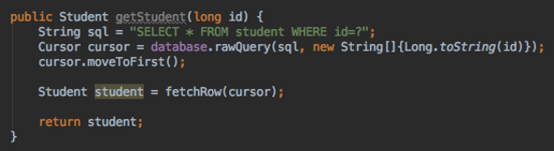
Task #11 Modify StudentDataSource: Add new function getStudent(long id)

Slide 33
Task #12 Modify DetailActivity: Load student data into view based on passed student id

Slide 34
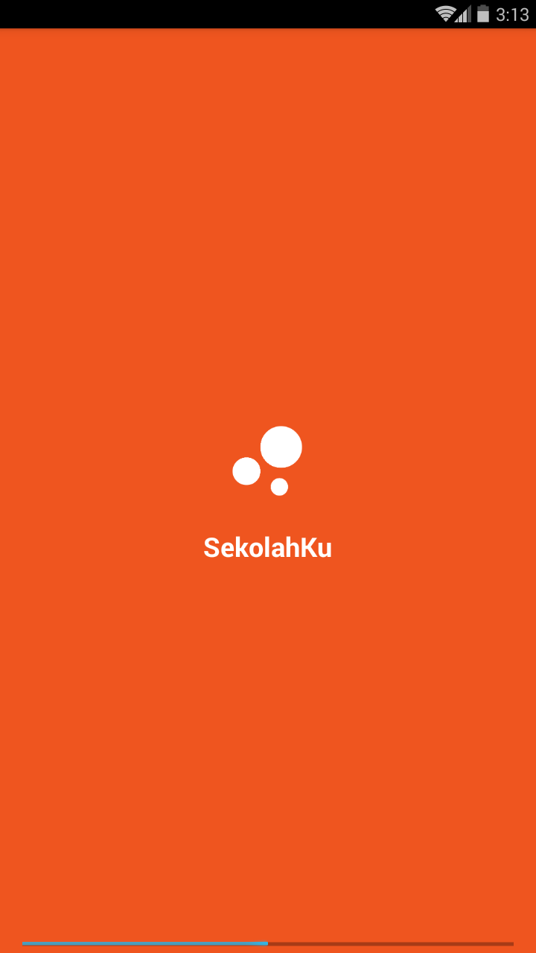
Task #13 Add new activity: SplashScreenActivity

